Slide 1
Inventory
Management System
The best Inventory Software for Stock Management

Slide 2
INDEX
Overview
Introducing: IMS Software
Understanding the problems
Employee Dashboard
Supplier Dashboard
Product Category Window
Product Manage Window
Manage Customer Bill Receipt
Billing Area Dashboard
Project objective
Target audience
Market trends
Project timeline
Cycle diagram
Thanks Note!

Slide 3
Overview
This presentation is based on the ‘Pariyojana Spardhanam 2022’ . In this Project exhibition event we are going to introduce our Project of Design Engineering Subject which is based on the Food and Supply chain Industry. This domain is dominated by the traditional methods from the past few years but in the last 5 years we have seen an immense growth and potential in this field because it eliminates the paperwork and makes the process efficient and fast.

Slide 4
Understanding the problems
01
Creating a Stock Management book or file is a tedious task and requires more efforts to maintain and manage those writings.
02
The whole process is slow and manual.
03
Integrity is not there in manual process, data which is written at one place can be manipulated by any staff or other easily because it does not have any access policy unlike in database.

Slide 5
Project objective
This Project is aimed to eliminate the problem of Non GUI based Softwares which are not easy to use and experience for the customers. So we introduced a complete GUI based project in python programming language with database integration.

Slide 6
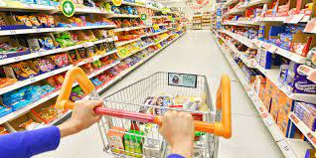
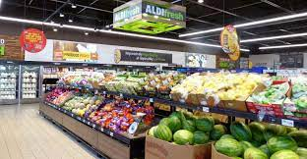
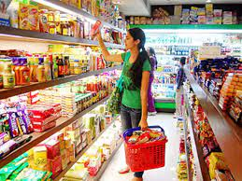
Target audience
Our targeted audience and stakeholders are retail shop owners, malls, supermarkets, wholesalers, etc. and indirect customers are admins, employees, managers, receptionist, etc.

Slide 7
Market trends
In the last 5 years the growth of digitized stock managements system softwares has increased exponentially and with the passage of time this will be developed further with more functionalities and ideas.
100%
100%
100%
80%
80%
80%
60%
60%
60%
40%
40%
40%
20%
20%
20%
0%
0%
0%
Q1
Q2
Q3
Q4
Q1
Q2
Q3
Q4
Q1
Q2
Q3
Q4
2015
2018
2020

Slide 8
Cycle diagram
Ideation
04
Prototype
We understand the market needs and worked according to that to solve this problem.
PDC and Demo videos are submitted in the design engineering portal in GTU.
01
03
Develop
Get feedback
The core development process includes the integration of technologies which are required to make this work.
After Project Completion we will take feedbacks from our customers who will be going to use them.
02

Slide 9
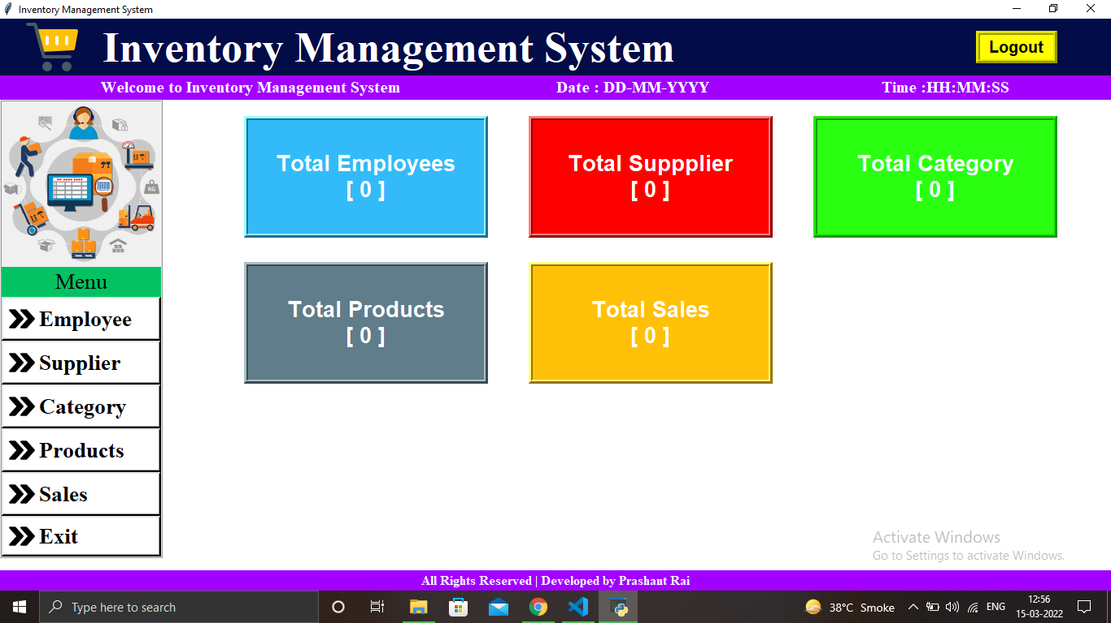
Introducing: Inventory Management System
Home Page or Main dashboard
A complete Desktop based GUI Application which is built in Python Language using the Sqlite database and Tkinter Module.

Slide 10
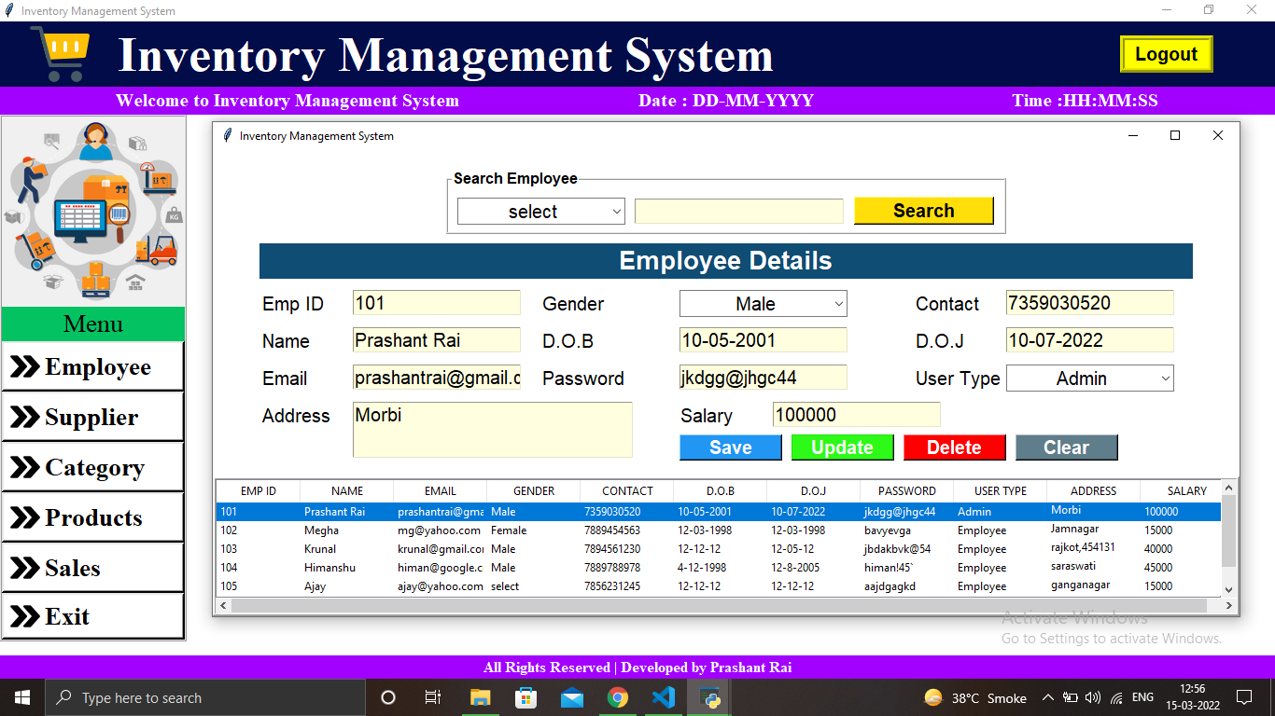
Employee Dashboard
This is Employee dashboard which can includes Emp-ID, Name, Salary, DOB, etc.
The Employee Dashboard is Managed by the Admin and he/she can operate all the CRUD operations on the Employee. Admin is Super key in the database table.

Slide 11
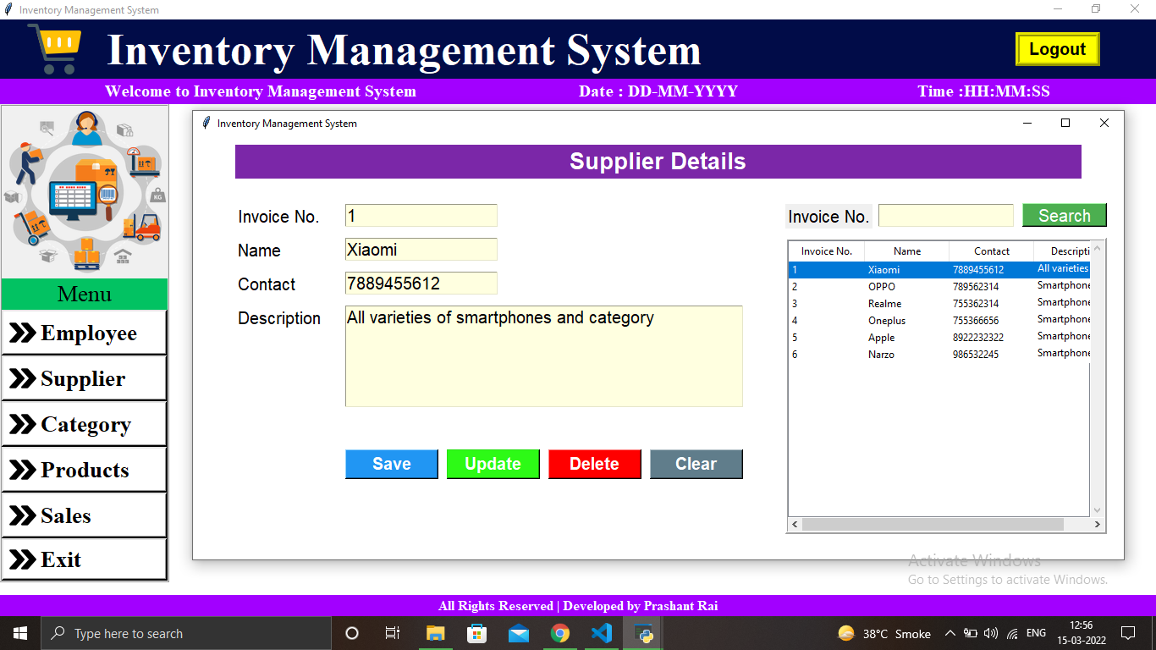
Supplier Dashboard
This is Supplier dashboard and it includes Invoice No. , Name, Contact and Description

Slide 12
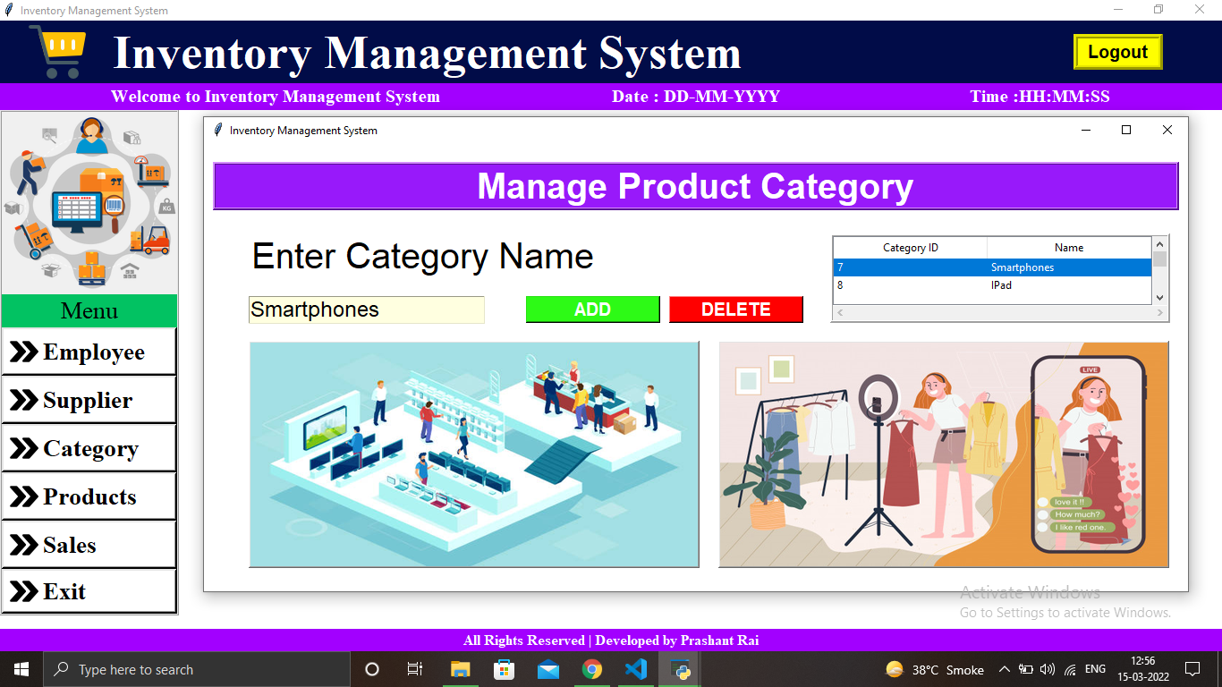
Product category Window
Here we can add different categories of product in the database and it will reflect on the preview bar
Product Category is managed here like performing delete and add functions and fetching data from the backend by clicking on the preview window.

Slide 13
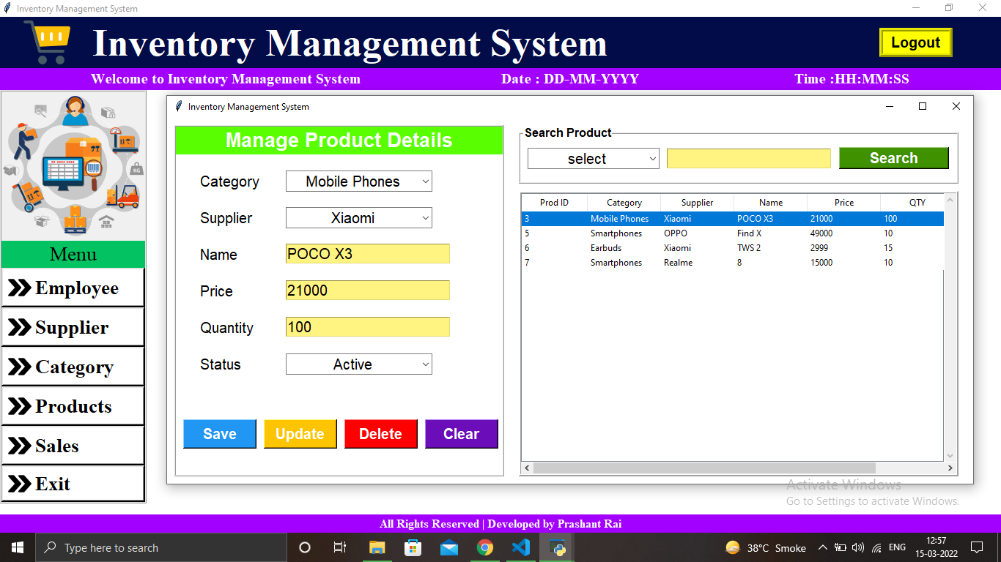
Product Manage Window
This window manages the product details like category, supplier, name, price, quantity.

Slide 14
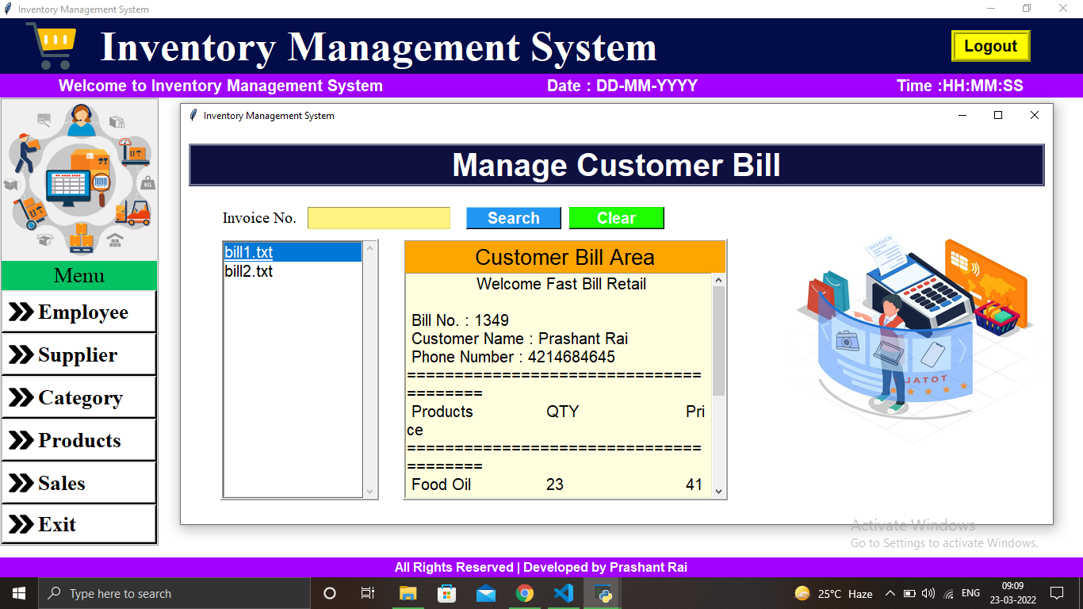
Manage Customer Bill Receipt
This window manages the already generated bills by searching, fetching data from the database

Slide 15
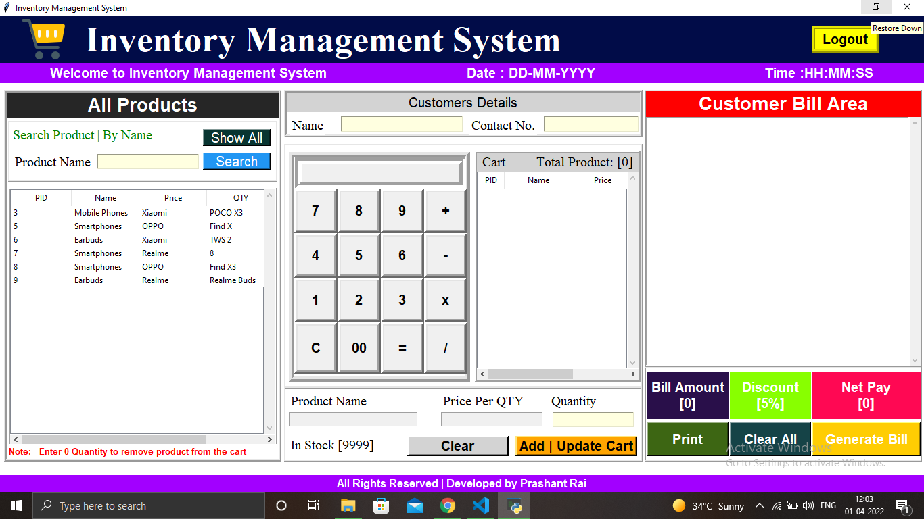
Billing Area
This is Billing dashboard and it consists of 3 frames
Products list, Calculate bills, Generate Receipt.
All the products can be fetched from the database and it will be reflected here also buttons are available to perform functions.

Slide 16
Project timeline
JAN
JAN
FEB
FEB
APR
APR
Ideation
Requirement
Design
Development
Testing Phase
Deployment
The Idea and domain is selected in this period.
All the requirements are noted and a complete plan is made.
Design implementations were done like Home Page, dashboards.
All the functionalities were introduced along with the frontend & database.
The Project is ready for the testing phase where functionalities will be checked.
After Testing phase Model will be deployed on github.

Slide 17


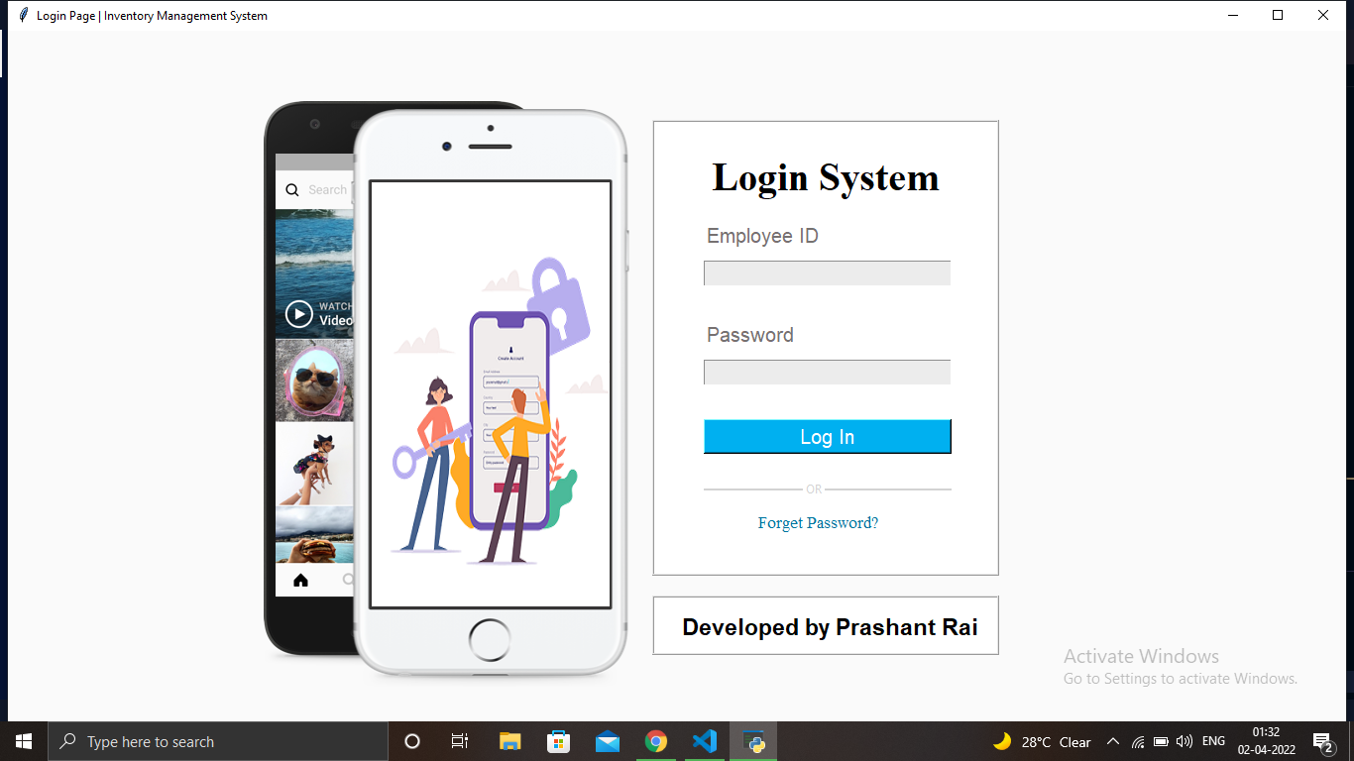
Thank you!
Prashant Rai
6th sem, Computer Science Engg.
Enrollment No. : 190040131512

